Slide 1


St. MARTIN’S ENGINEERING COLLEGE
UGC Autonomous
NBA & NAAC A+ ACCREDITED
Dhulapally, Secunderabad – 500 100
Department of
ARTIFICIAL INTELLIGENCE & DATA SCIENCE
Mini Project on
Loan Eligibility Prediction for Banks using Machine Learning
Batch No: 13
M. Rajesh
K. Sree Akhil
CH. Ram Mahideep Varma
(23K81A7296) (23K81A7292) (23K81A7279)
Under the Guidance of Mr. V. Vishnu Vardhan Assistant Professor
Department of Artificial Intelligence & Data Science

Slide 2
OUTLINE
Abstract.
Overall Design.
Experimental Results.
Performance Evaluation.
Conclusion and Future Enhancement.
References.
Contribution of the Project (Impact).
100% of Code Implementation – Demo.

Slide 3
ABSTRACT
The demand for loans has increased significantly for both personal and business purposes. Due to limited assets, banks cannot grant loans to every applicant. And the Loan approval processes in banks often depend on manual process, which leads to delays, biases, and high default risks. So, In this project we introduces a machine learning - based system to predict loan eligibility accurately and efficiently and within less time. Using a datasets including features like income, credit history, employment status, loan amount, and tenure. In this we applied supervised learning algorithms including Logistic Regression, Decision Trees, Random Forest, and Support Vector Machines. Data preprocessing involves in handling missing values, encoding categorical variables.

Slide 4
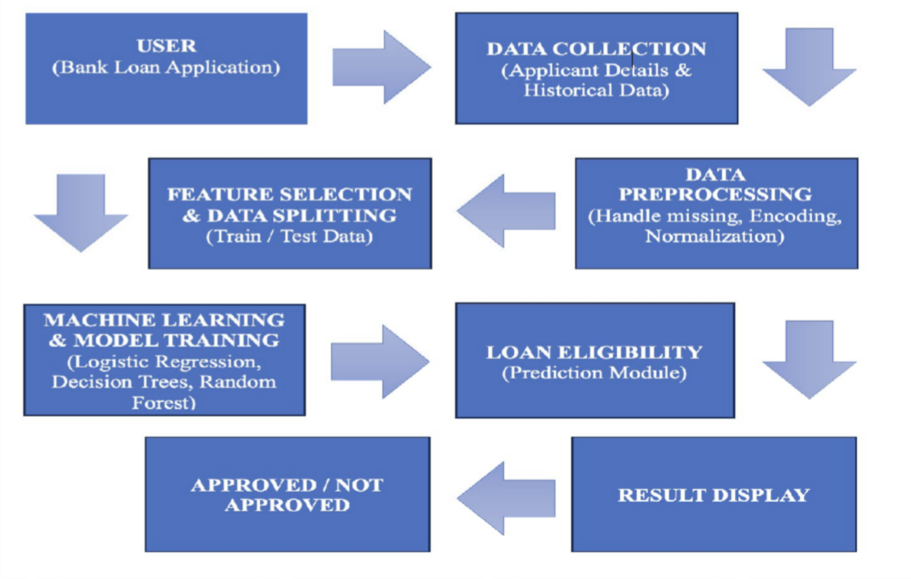
OVERALL DESIGN

Slide 5
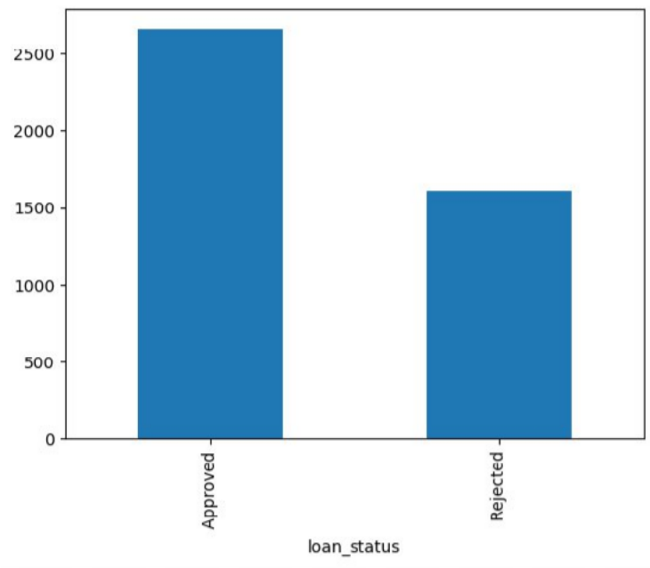
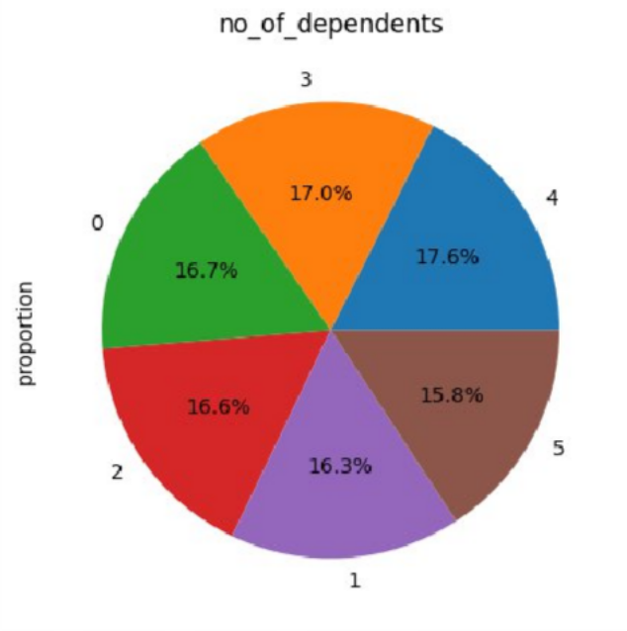
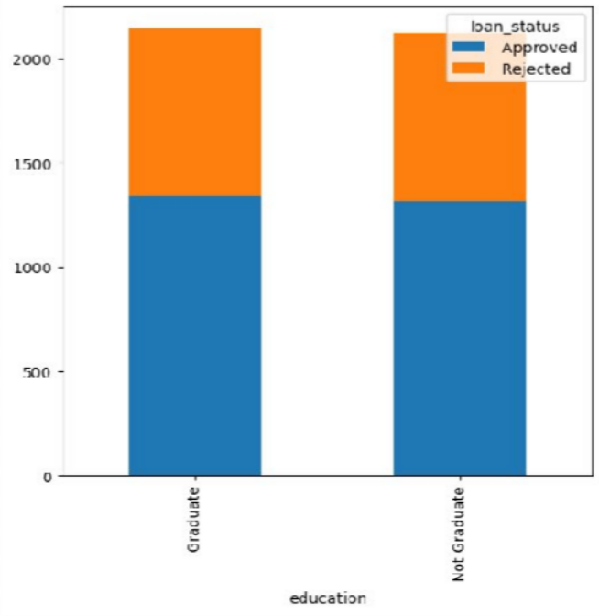
EXPERIMENTAL RESULTS
LOAN STATUS
(Bar Graph)
COMPARISON OF DEPENDENTS
(Pie Chart)
COMPARISION IN EDUCATION
(Stacked Bar Chart)

Slide 6
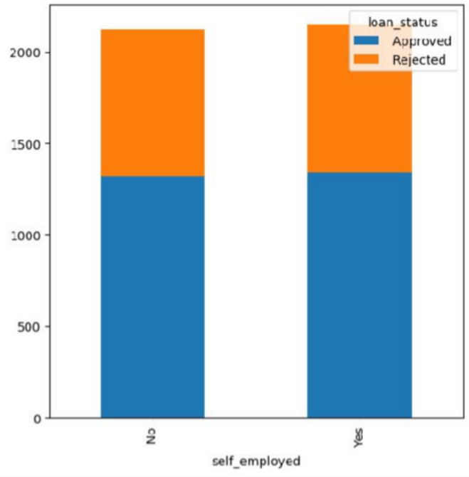
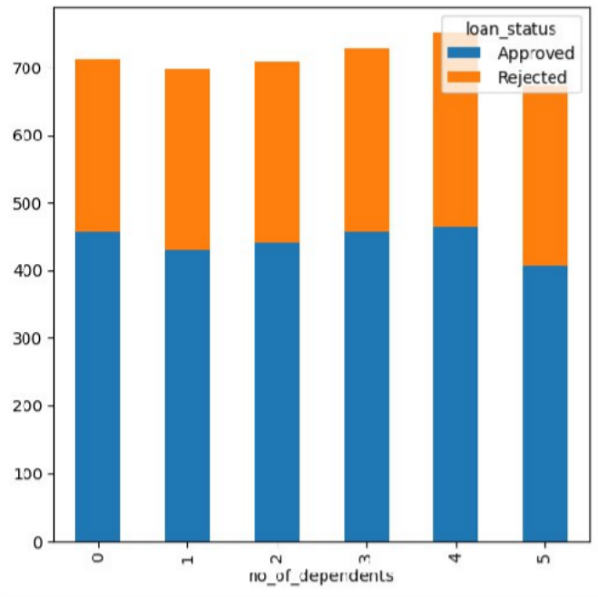
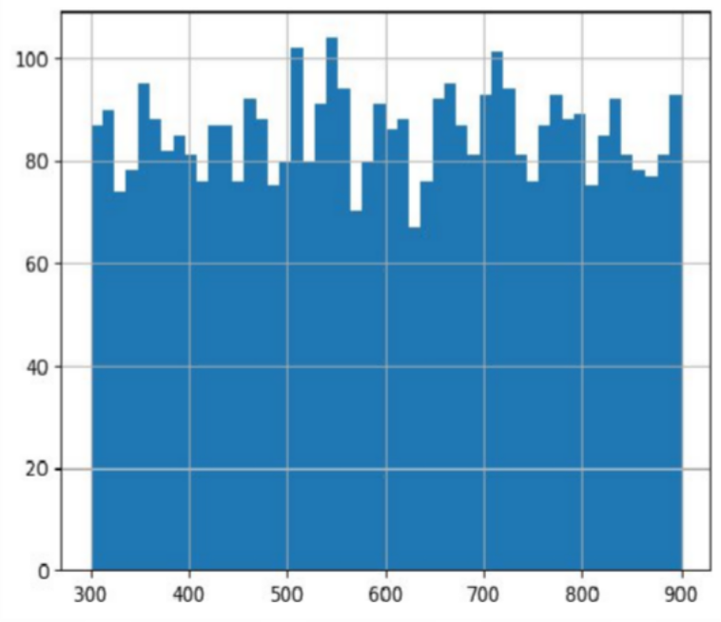
COMPARISION IN SELF EMPLOYED
(Stacked Bar Chart)
NO. OF DEPENDENTS
(Stacked Bar Chart)
DISTRIBUTION OF THE VARIABLES
(Histogram)

Slide 7
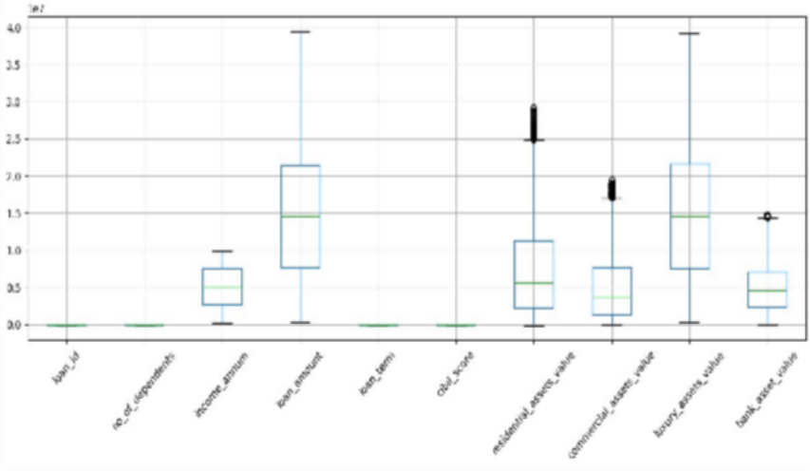
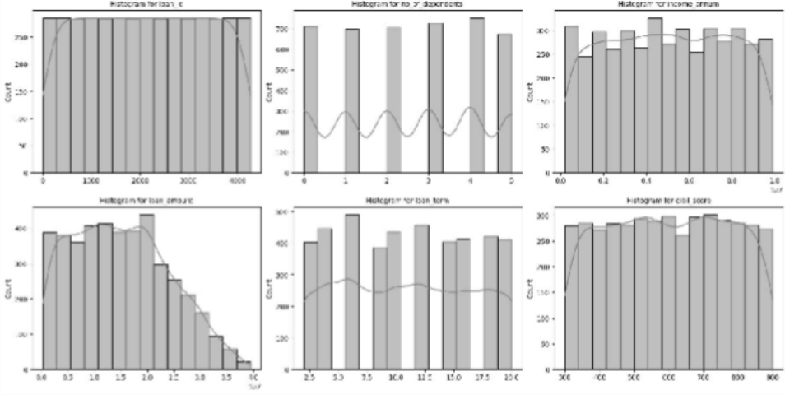
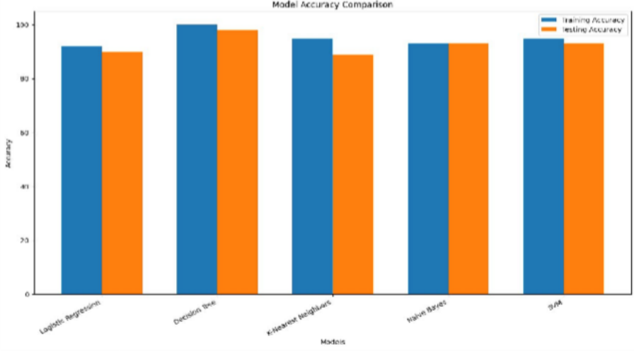
CHECKING OUTLIERS FOR NUMERICAL COLUMNS
(Box Plot)
REPRESENTATION OF ALL DATA SETS
(Histogram)
COMPARISON OF ALL MODELS
(Grouped Bar Chart)

Slide 8
PERFORMANCE EVALUATION
Performance evaluation is used to measure the accuracy and effectiveness of machine learning models used for loan eligibility prediction. Different evaluation metrics are applied to analyse how well the model classifies loan applications as eligible or not eligible.
The performance of models such as Logistic Regression, Decision Tree, Random Forest, and Support Vector Machine (SVM) is evaluated using standard classification metrics (Accuracy, Precision, Recall, F1 Score).

Slide 9
ALGORITHM | ACCURACY | PRECISION | RECALL | F1 SCORE
LOGISTIC REGRESSION | 82% | 81% | 83% | 82%
DECISION TREE | 79% | 78% | 80% | 79%
RANDOM FOREST | 88% | 87% | 89% | 88%
SVM | 84% | 83% | 85% | 84%
COMPARISON OF ALL MODELS
(Tabular Format)
*Accuracy shows how many total predictions are correct out of all loan applications.
*Precision tells us how reliable the model is when it approves a loan.
*Recall tells us how well the model identifies applicants who should actually get the loan.
*F1 Score tells us how well the model balances false approvals and missed approvals.

Slide 10
CONCLUSION AND FUTURE ENHANCEMENT
Conclusion:-
Our project Loan Eligibility Prediction for Banks using Machine Learning is used to assist/support banks in making faster and more accurate loan approval decisions. The system uses historical loan applicant data and machine learning algorithms to predict whether a customer is eligible for a loan.
During the project development, the dataset was collected and pre-processed by handling missing values, encoding categorical variables, and normalizing the data. Several machine learning algorithms such as Logistic Regression, Decision Tree, Random Forest, and Support Vector Machine (SVM) were implemented to train the prediction model.

Slide 11
The performance of these models was evaluated using standard classification metrics such as Accuracy, Precision, Recall, and F1 Score. Among the tested algorithms, the Random Forest model produced the highest accuracy and better prediction performance compared to the other models.
Overall, the project demonstrates how machine learning can be effectively used to automate and improve the loan eligibility prediction process.
Future Enhancement:-
Advanced Machine Learning Models.
Real-Time Loan Prediction System.
Larger Dataset Integration.
Web-Based Application.

Slide 12
REFERENCES
Reserve Bank of India - Credit Risk Management Guidelines:-
https://www.rbi.org.in
Kaggle - Loan Prediction Dataset:- https://www.kaggle.com
Scikit-learn - Documentation:- https://scikit-learn.org
Tom M. Mitchell - Machine Learning - McGraw-Hill:- 1997 (Education Company)
Loan Eligibility Prediction Using Machine Learning - Sanketika Vidya Parishad Engineering College:- 23rd July, 2025

Slide 13
CONTRIBUTION OF THE PROJECT (Impact)
The loan eligibility prediction system contributes to improving the loan approval process in banks by using machine learning techniques. It helps financial institutions analyse customer information efficiently and make accurate loan approval decisions.
Improved Decision Making.
Reduction of Manual Work.
Faster Loan Processing.
Risk Reduction for Banks.
Data-Driven Insights.

Slide 14
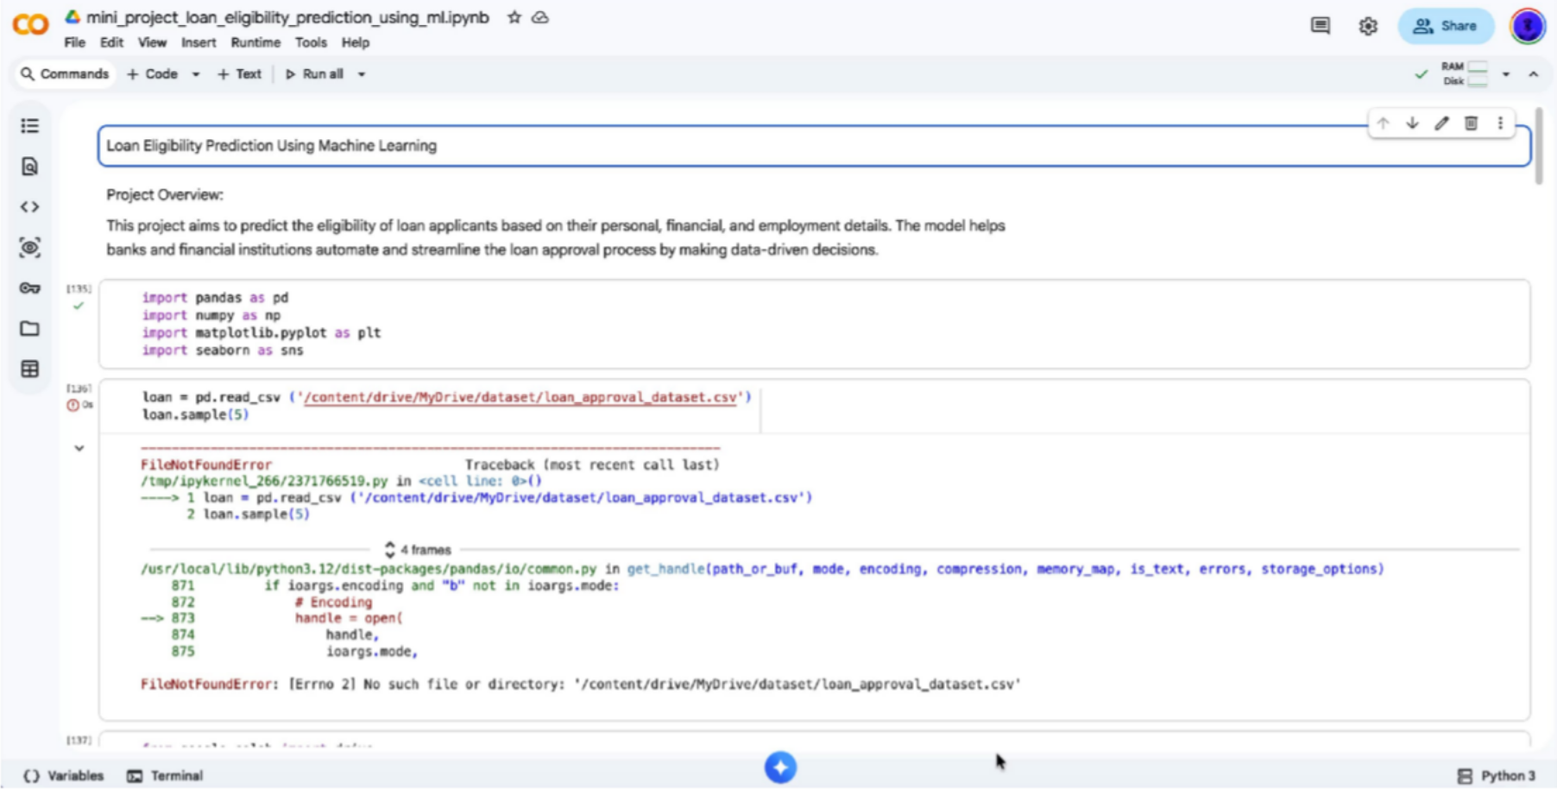
100% of Code Implementation (Demo)

Slide 15
QUERIES ??

Slide 16
THANK YOU

